Slide 1
Programming Project Robot maze
1_Manasik kamal aldeen
2_Abrar Mohamed abdalla
3_Refga alser osman altaher
4_Maab Amir Abdalwhab
5_Jamal Ibrahim Hassan
6_Munther Abdel Ghaffar

Slide 2
Introduction:
Programming: It is a set of detailed, step-by-step instructions to direct the computer to do what you want it to do.Programming can also be defined as the language of communication between humans and machines. Humans are accustomed to using different languages, such as Arabic or English, to communicate with each other. Likewise, a group of languages ​​has been invented to communicate between humans and machines, and these languages ​​are called programming languages. These languages ​​are simply... The process of writing commands and instructions, and the computer converts them into a language that it understands and executes its commands...

Slide 3
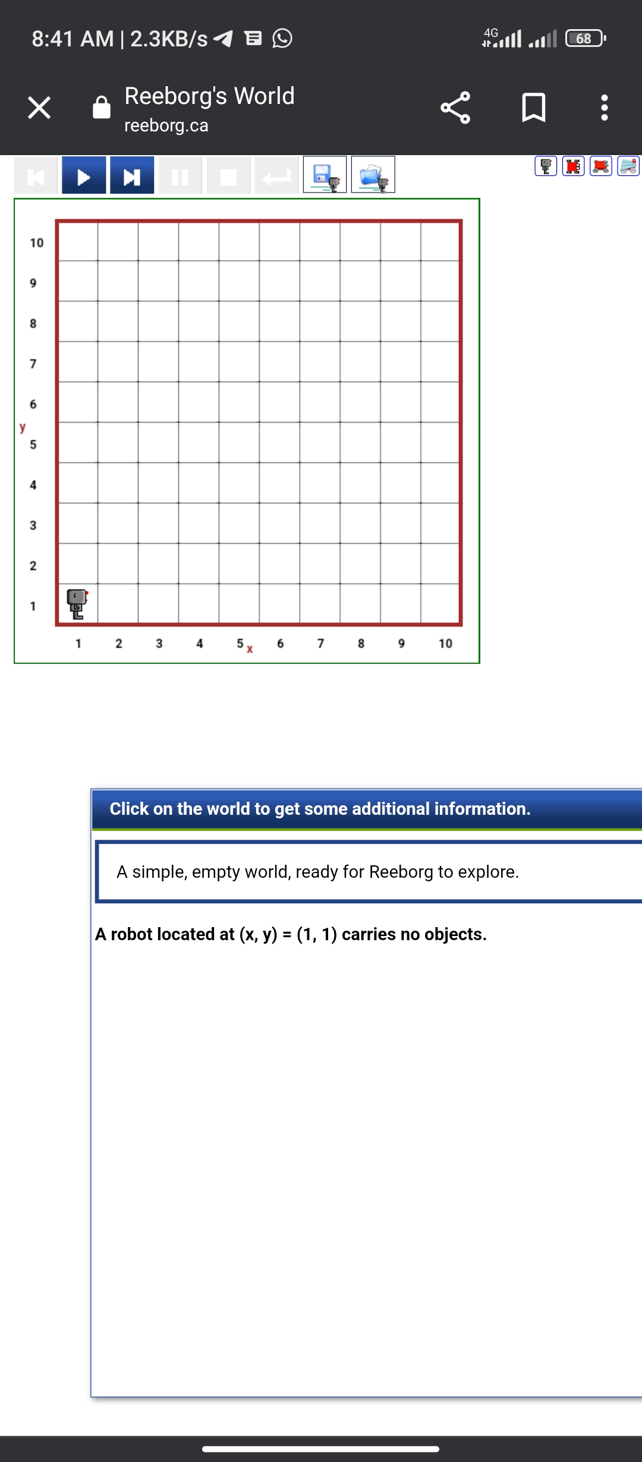
The idea behind the project:-
A robot moves according to the directions of the programmer or user using codes belonging to the Python language. In the world of reborg, there are specific codes for the robot to move, but we and our colleagues have added some codes through function.

Slide 4
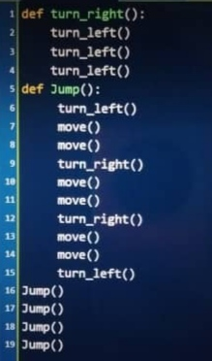
Code:-
As for the codes, we added new codes that are not present in the world of reborg. The codes are:
1-turn-right
2-jump
B: The first code is used to make the robot turn right
The second one is used for jumping

Slide 5
The function
def turn -right(): The function responsible for directing the robot to Yemen and contains
turn_left()
turn_left()
turn_left()
●As for the jump action
It is responsible for the robot jumping between barriers and contains some of the codes
move. move
turn_left
turn_right
We set 6 barriers for the robot to pass using the codes we created
And when you write jump
6 times in a row, the robot jumps six jumps until it reaches the end of the hurdles or the flag placed at the end of the hurdles

Slide 6
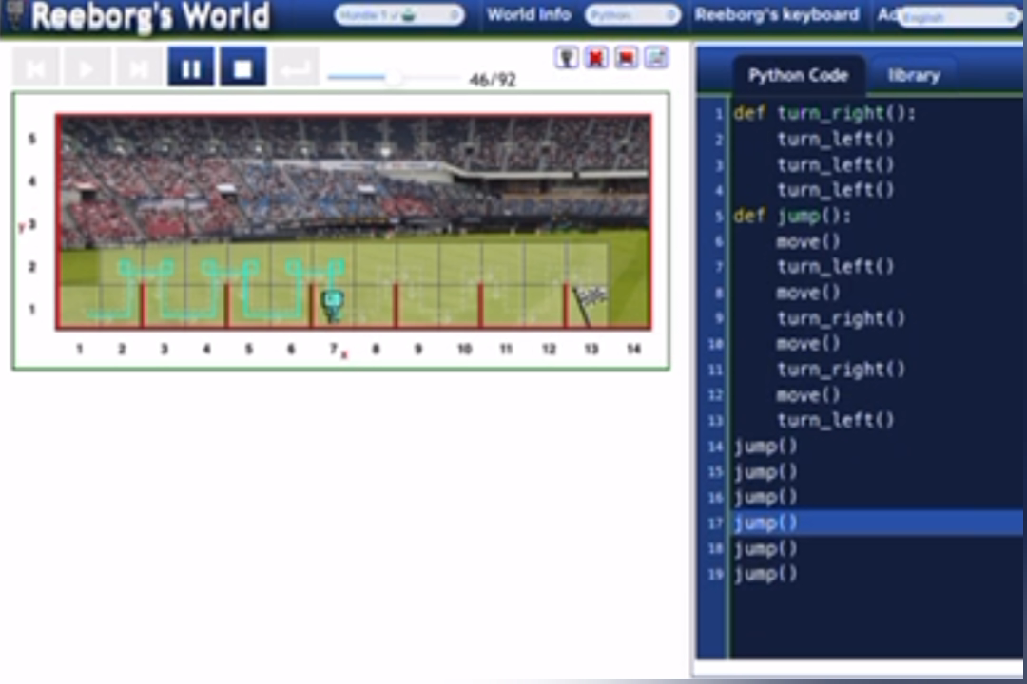
When you press run, the robot starts moving one step forward, then it turns left, then it takes a step up, then it turns right, then it takes a step, it turns right, it takes a step, then it turns left, and so on until the end of the barriers.

